Slide 1
Art 3066
RAT Study Images
Unit 3
Cubism

Slide 2
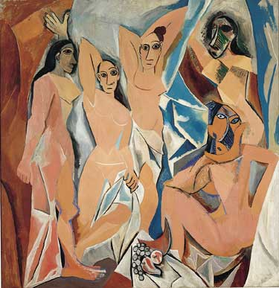
Pablo Picasso, Les Demoiselles d’Avignon, 1907
Notes:
Pablo Picasso, Les Demoiselles d’Avignon, 1907, oil on canvas, 8′ x 7′ 8″ (243.9 x 233.7 cm) (Museum of Modern Art, New York)

Slide 3
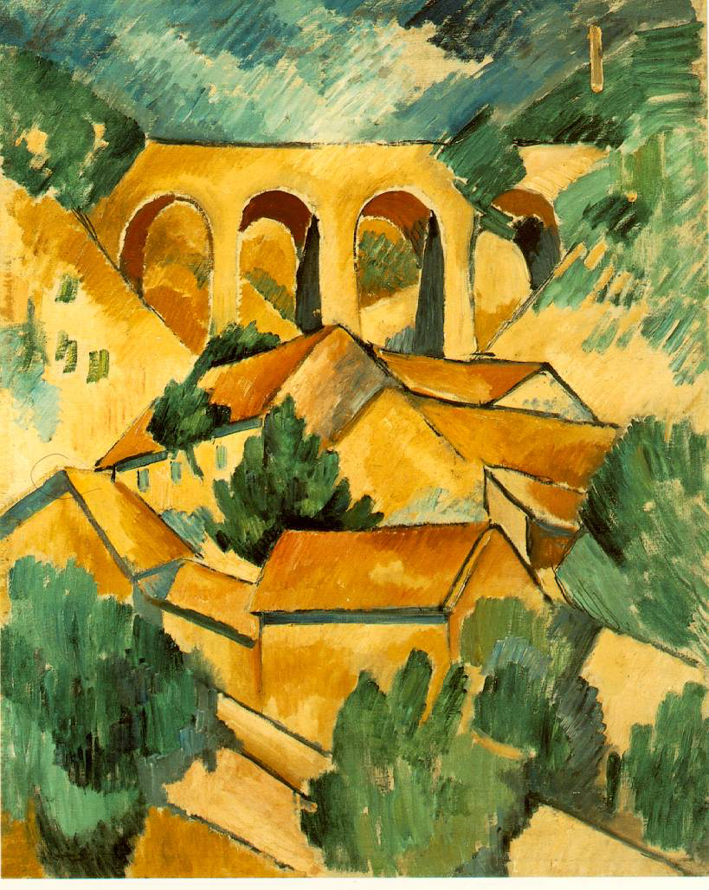
Georges Braque, Le Viaduc à L’Estaque
Notes:
Georges Braque, Le Viaduc à L’Estaque, (The Viaduct at L’Estaque), 1908, oil on canvas, 28-5/8 x 23-1/4″ / 72.5 x 59 cm (Musée national d’art moderne, Centre Pompidou, Paris)

Slide 4
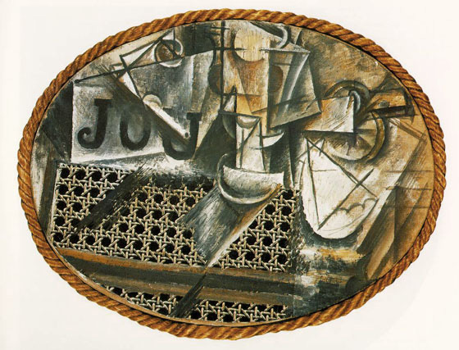
Pablo Picasso, Still Life with Chair Caning
Notes:
Pablo Picasso, Still Life with Chair Caning, 1912, oil on oil-cloth over canvas edged with rope, 29 x 37 cm (Musée Picasso)

Slide 5
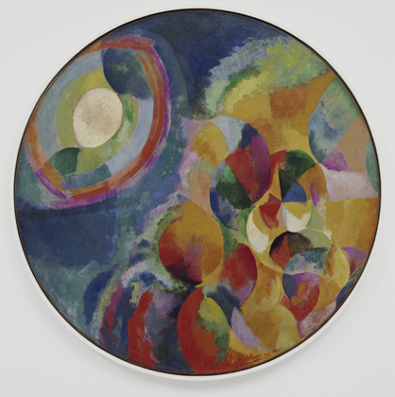
Robert Delaunay, Simultaneous Contrasts: Sun and Moon Paris, 1913
Notes:
Robert Delaunay, Simultaneous Contrasts: Sun and Moon Paris 1913 (dated on painting 1912), oil on canvas, 53" (134.5 cm) in diameter (MoMA, New York)

Slide 6
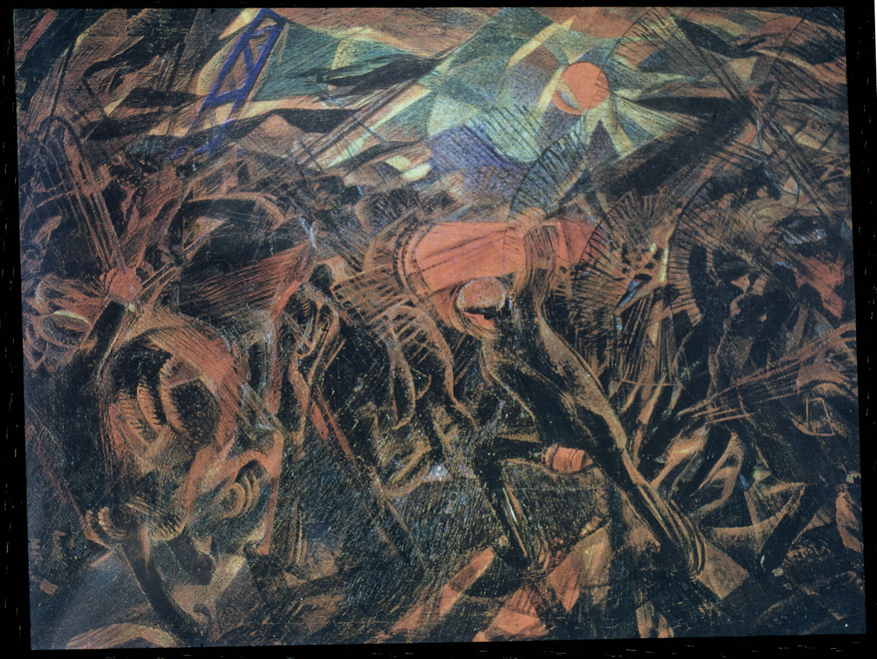
Carlo Carrà, Funeral of the Anarchist Galli
Notes:
Carlo Carrà, Funeral of the Anarchist Galli (I funerali del anarchico Galli), 1910-11, oil on canvas, 198.7 x 259.1 cm (The Museum of Modern Art, New York)

