Slide 1
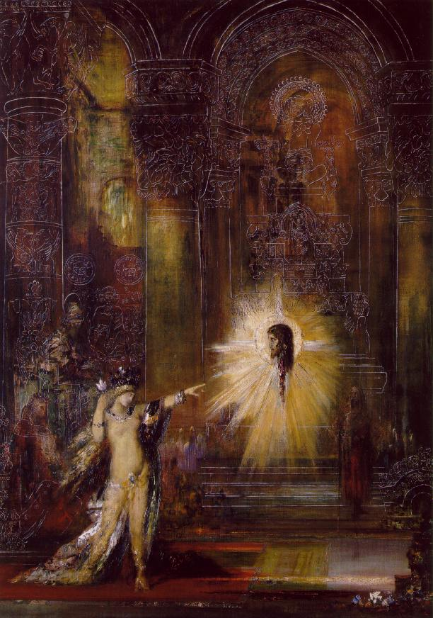
Gustave Moreau, Salome,
c. 1875

Slide 2
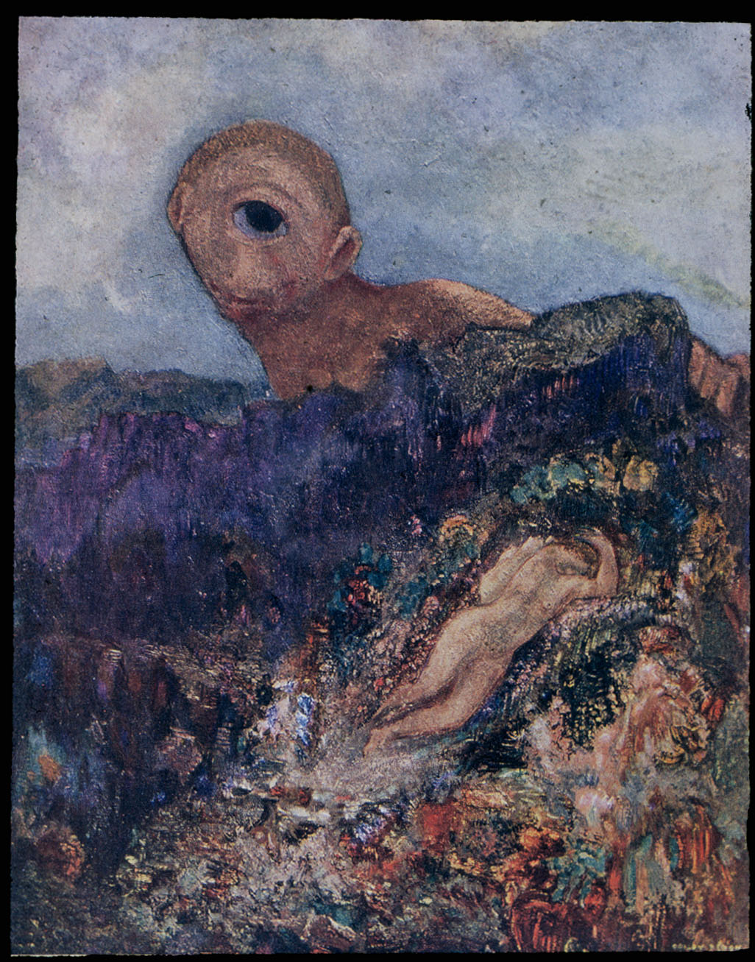
Odilon Redon,
Cyclops, c. 1870

Slide 3
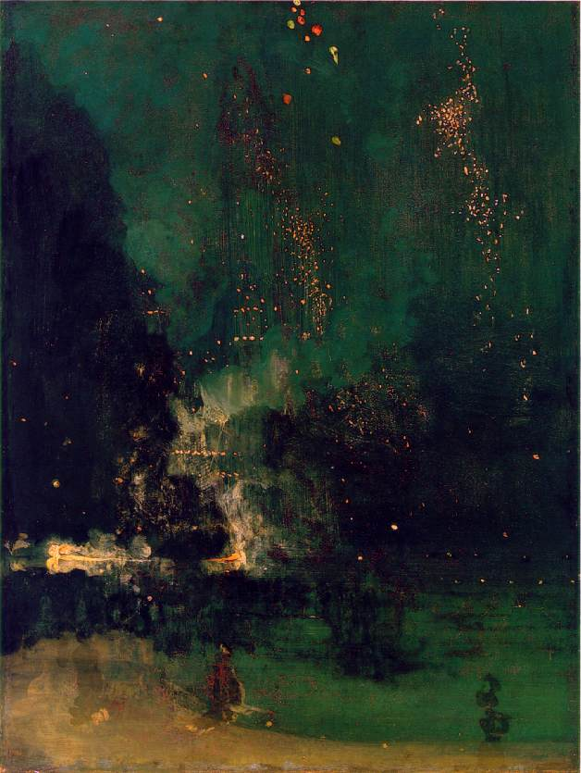
James McNeill Whistler
Falling Rockets/Nocturne in
Black and Gold, 1875

Slide 4
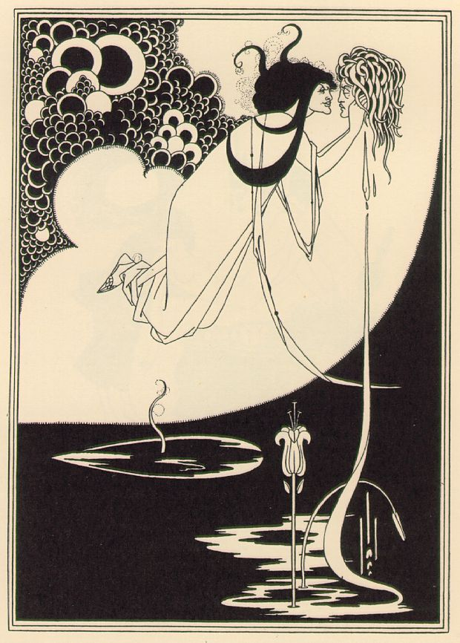
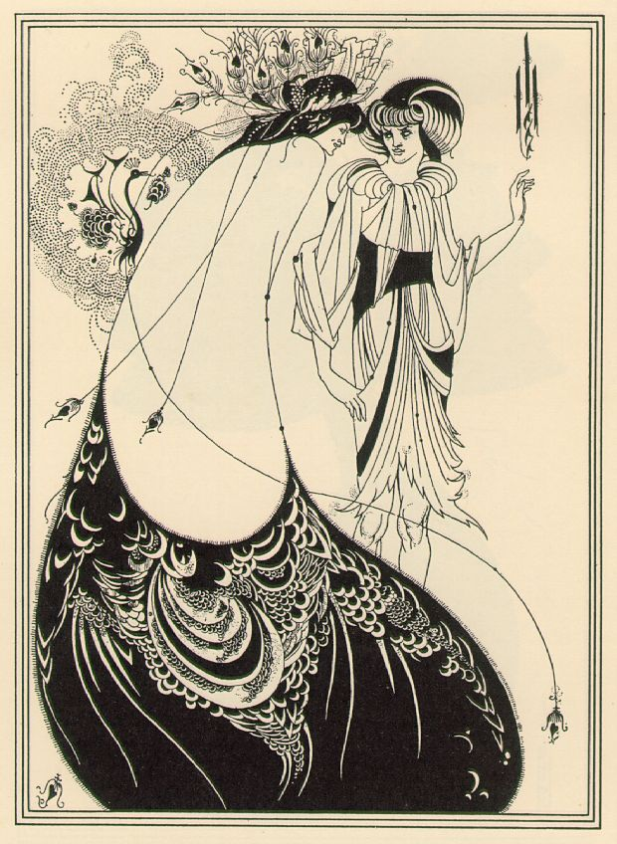
Aubrey Beardsley, Illustrations for Oscar Wilde’s Salome, 1893

Slide 5
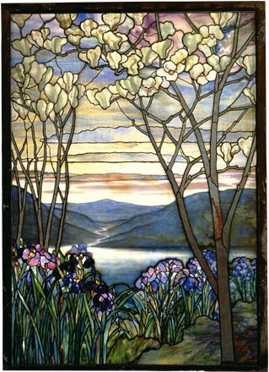
Louis Comfort Tiffany,
Magnolias and Irises,
1908

Slide 6
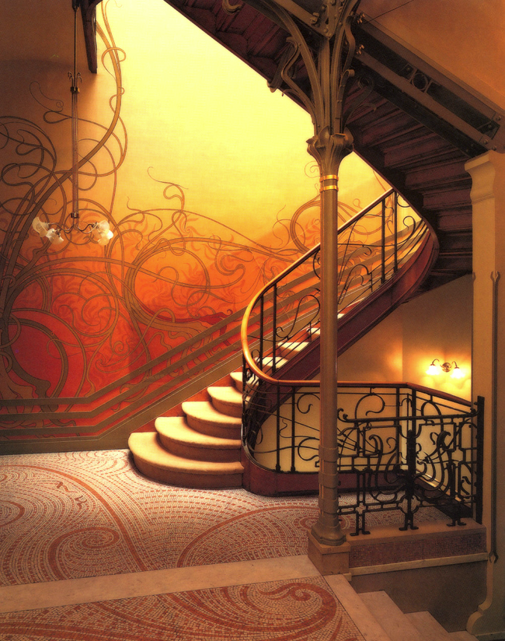
Victor Horta, Tassel House
Brussels, 1892

Slide 7
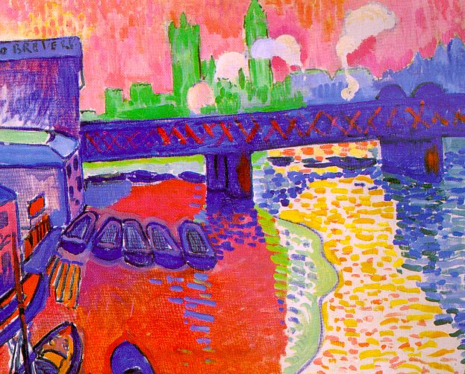
Andre Derain, Charing Cross Bridge, c . 1906

Slide 8
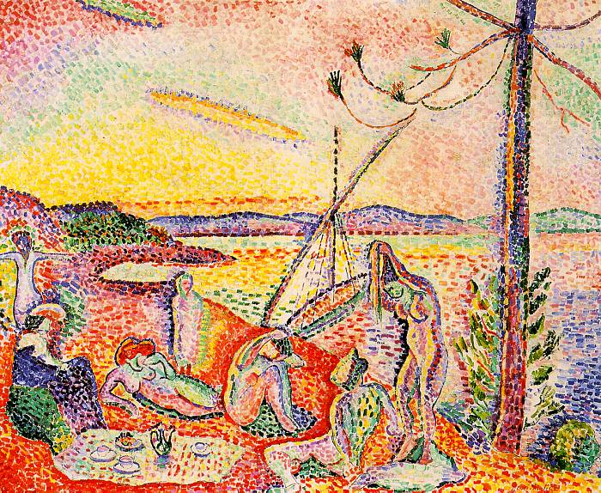
Matisse, Luxe, Calme, et Volupte, 1904

Slide 9
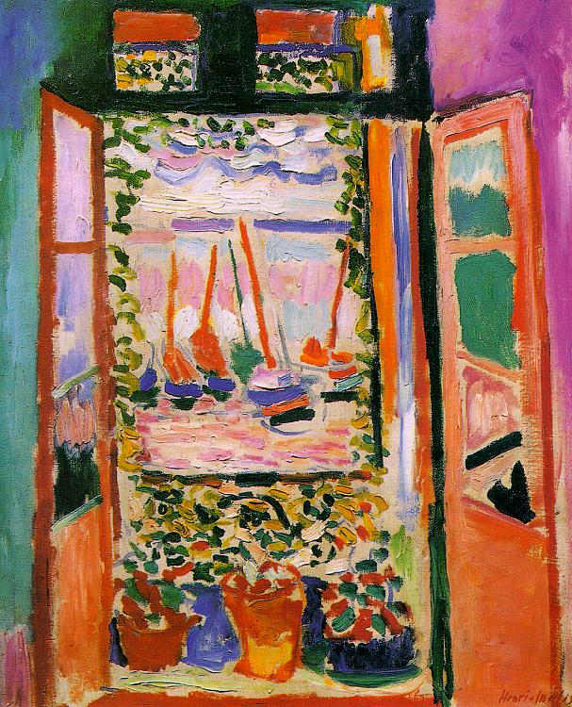
Henri Matisse, The Open
Window, 1905

Slide 10
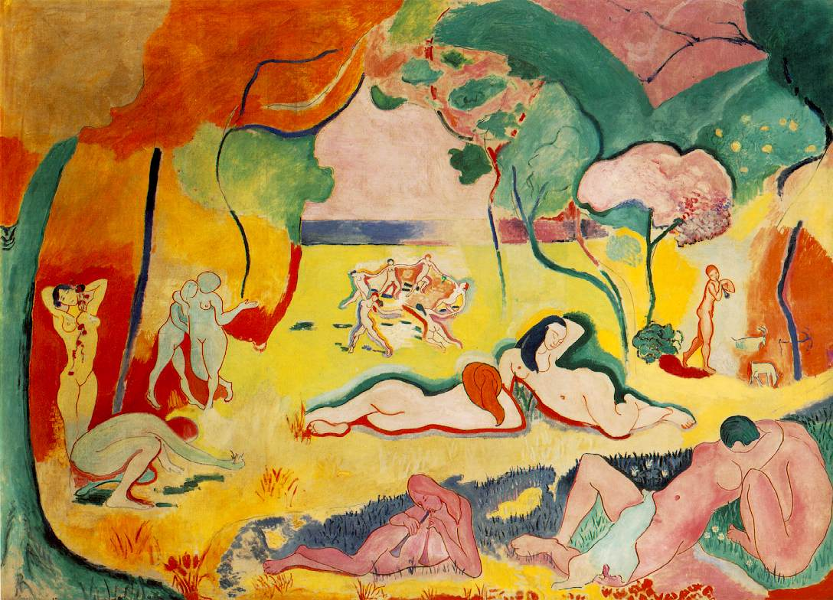
Matisse, Joy of Life, 1905-6

Slide 11
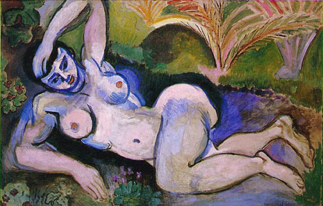
Matisse, The Blue Nude, 1905

Slide 12
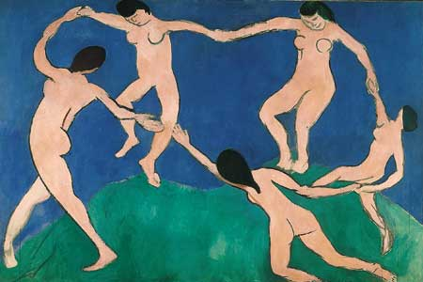
Matisse, Dance I, 1909

Slide 13
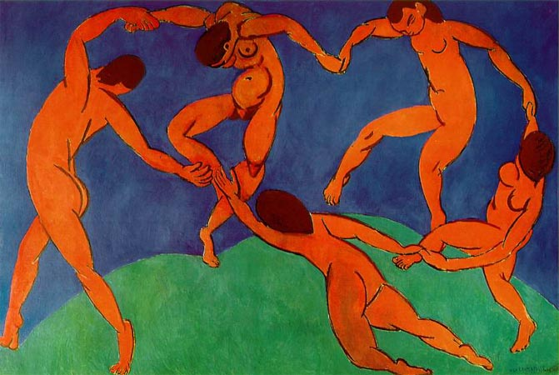
Matisse, The Dance, 1910

Slide 15
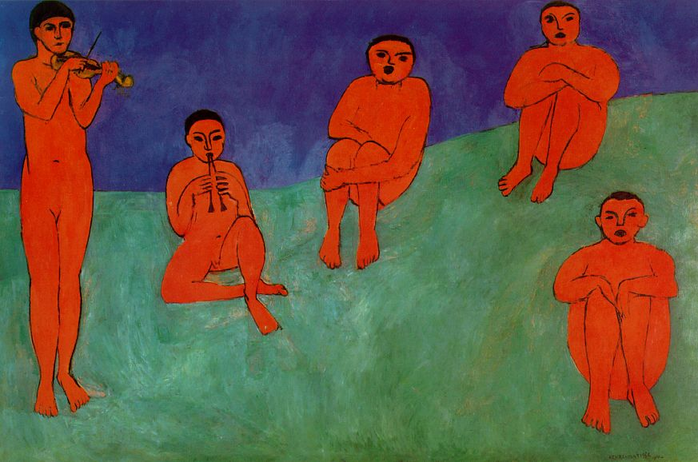
Matisse, Music, 1910

Slide 16
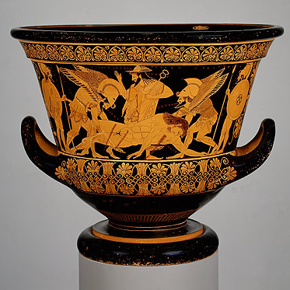

Slide 17
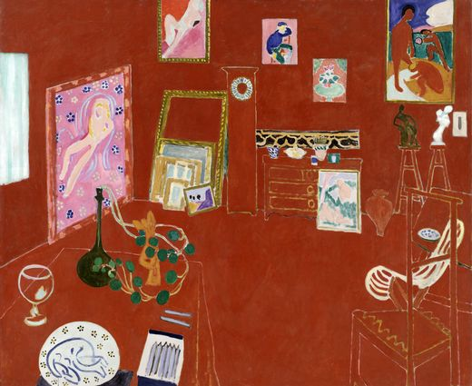
Matisse, The Red Studio, 1911

Slide 18
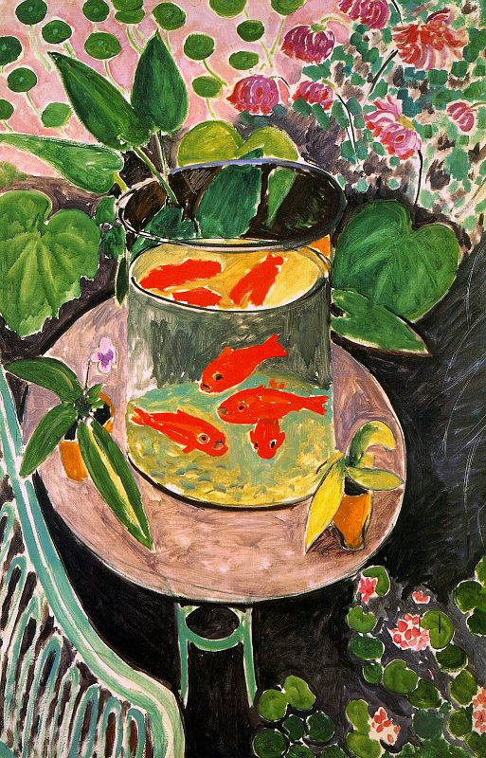
Matisse, Goldfish, c. 1912

Slide 19
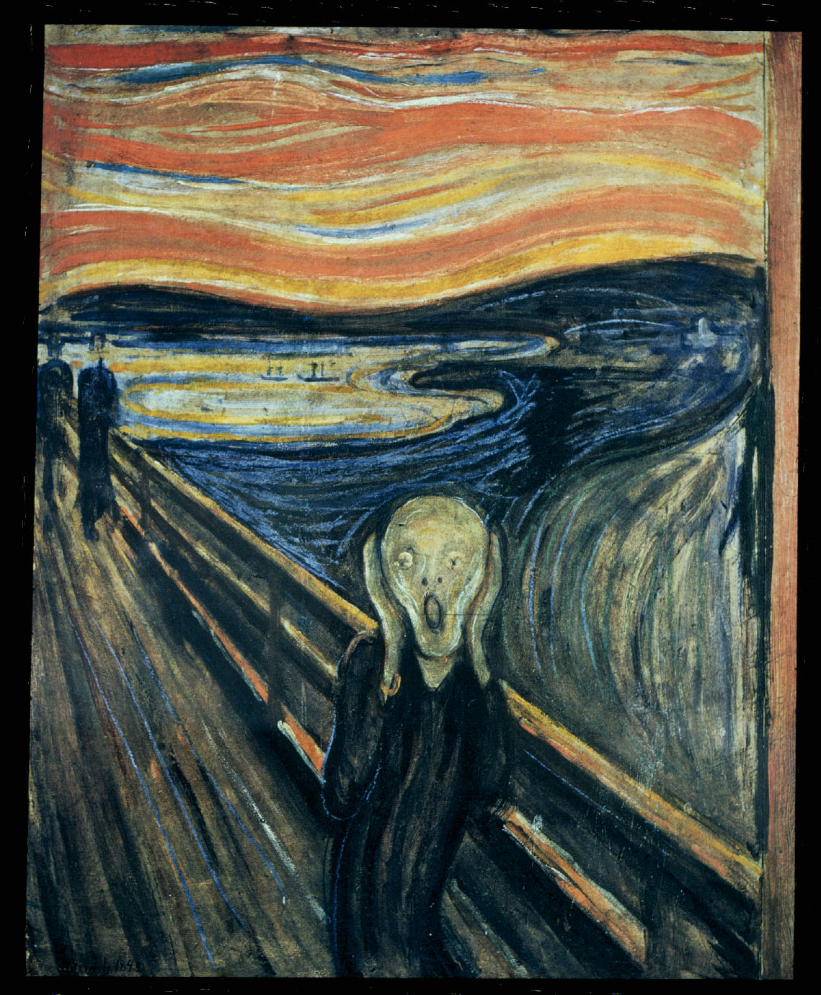
Edward Munch, The Scream
1893

Slide 20
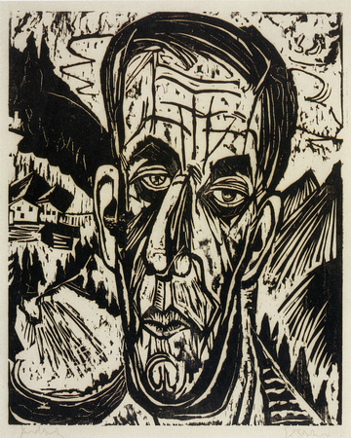
Kirchner
Portrait of Henry van de Velde
1917

Slide 21
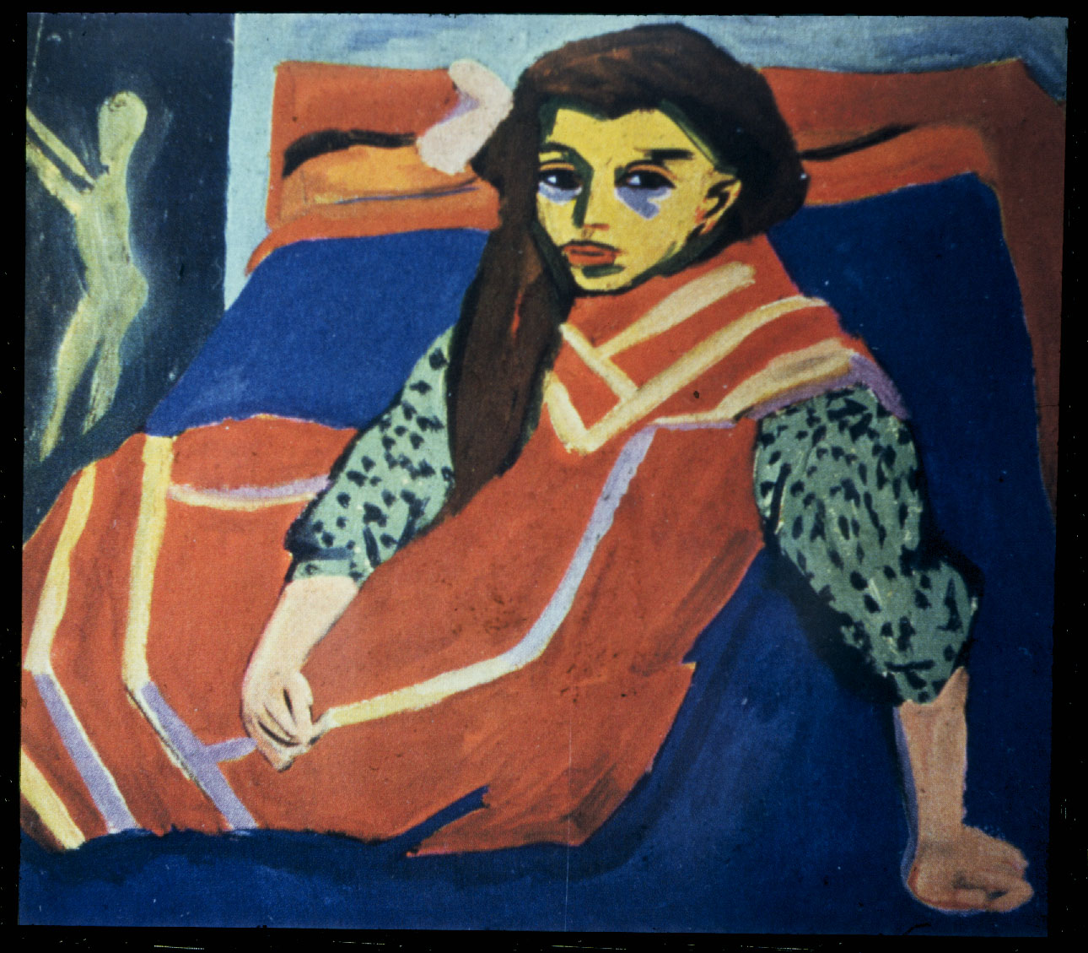
Ernst Ludwig Kirchner, Woman on a Blue Divan, 1907

Slide 22
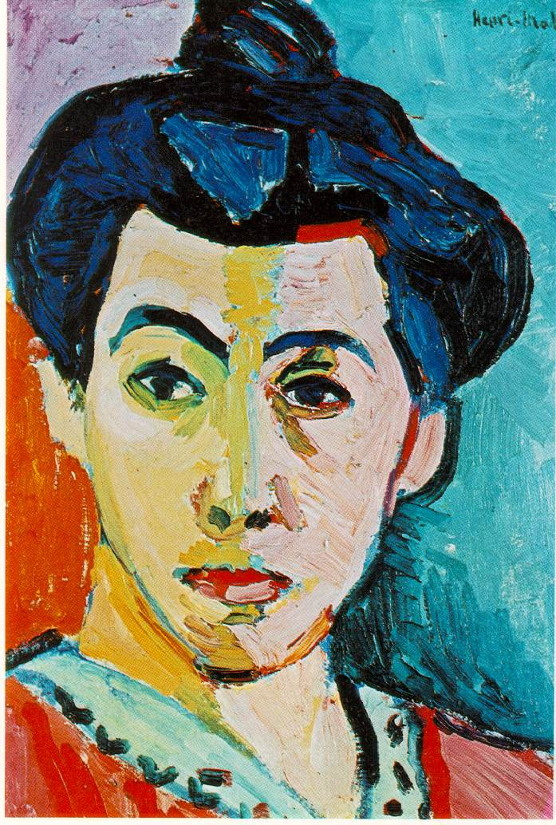

Slide 23
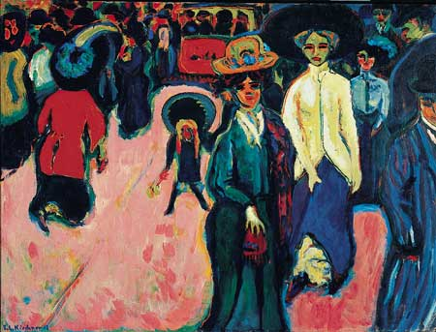
Ernst Ludwig Kirchner, The Street, 1908

Slide 24
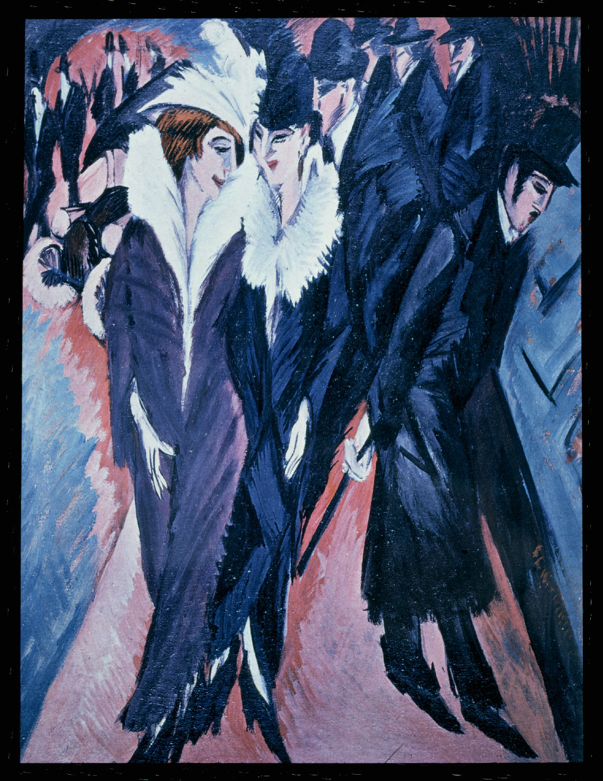
Ernst Ludwig Kirchner,
The Street, 1913

Slide 25
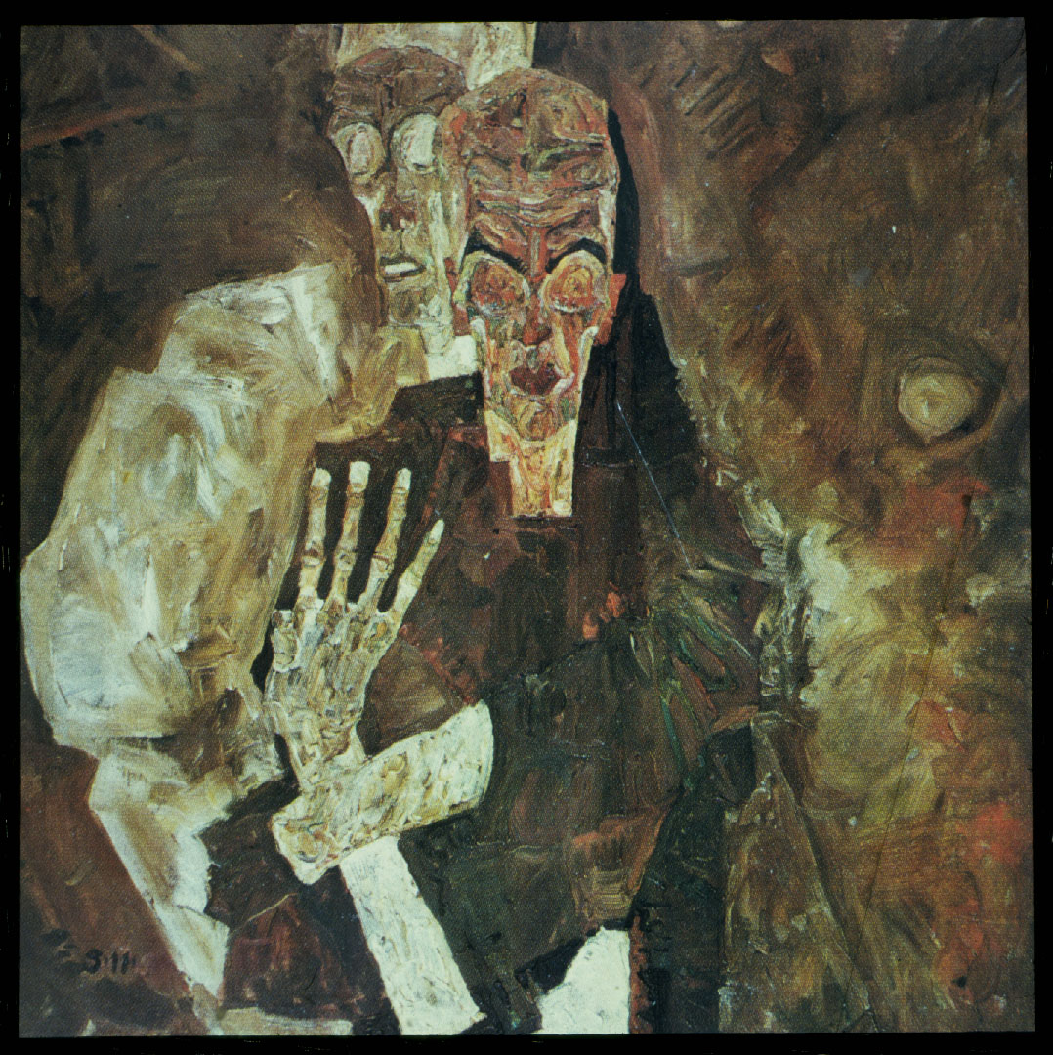
Egon Schiele,
Self-Seer II (Death
And the Man), 1911

Slide 26
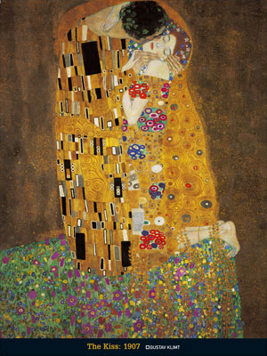

Slide 27
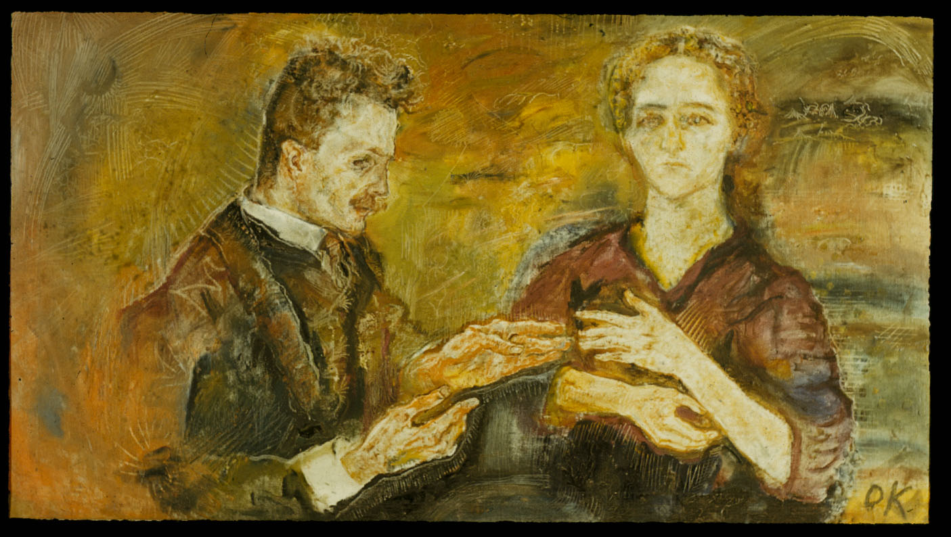
Oskar Kokoschka, Hans and Erica Tietz, 1909

Slide 28
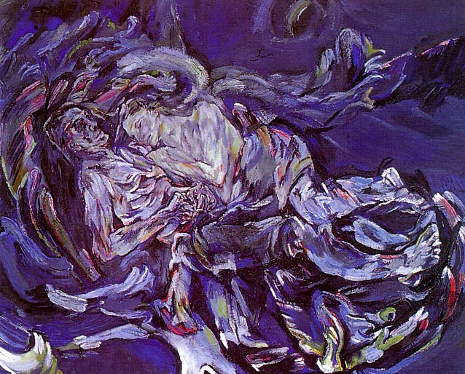
Kokoschka, Bride of the Wind, 1914

Slide 29
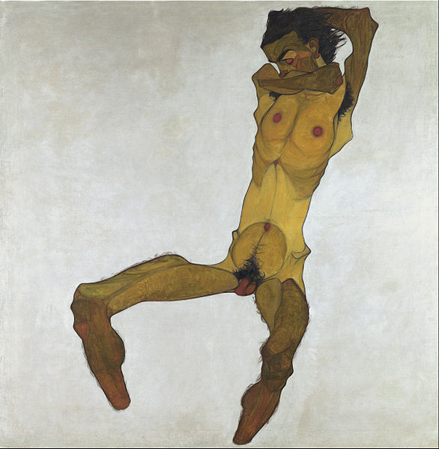
Egone Schiele, Seated Male Nude, 1910

