Slide 1
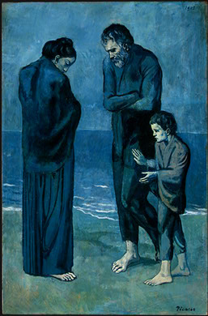
Picasso, Tragedy, 1903

Slide 2
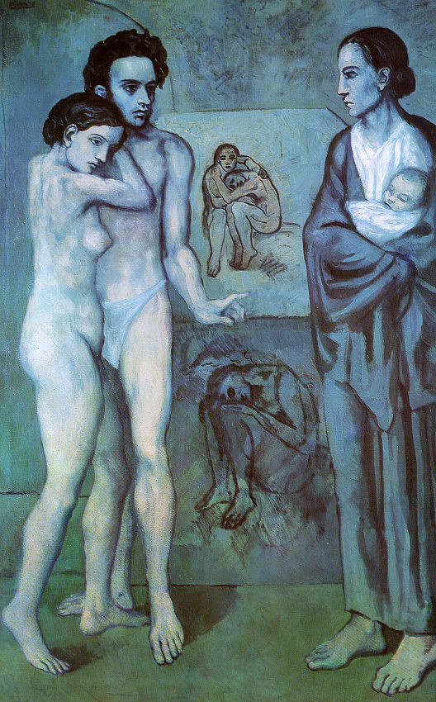
Picasso, La Vie, 1903

Slide 3
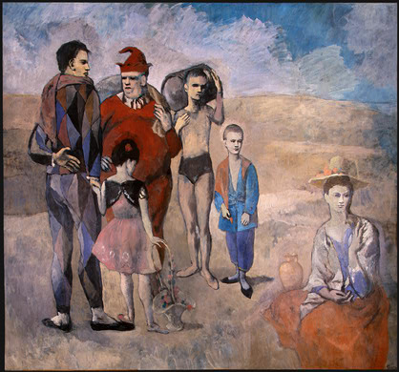
Picasso, Family of Saltimbanques, 1905

Slide 4
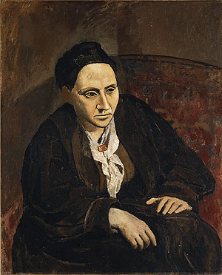
Picasso, Portrait of Gertrude Stein
1906

Slide 5
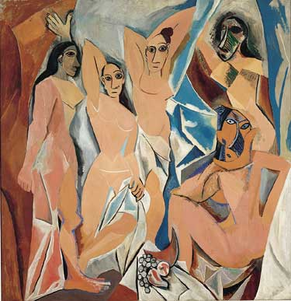
Les Demoiselles d’Avignon, 1907

Slide 7
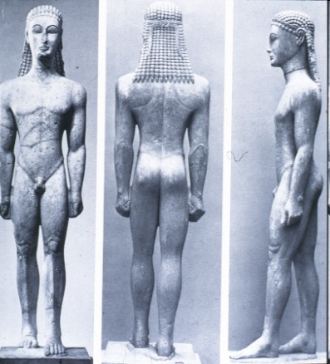

Slide 8
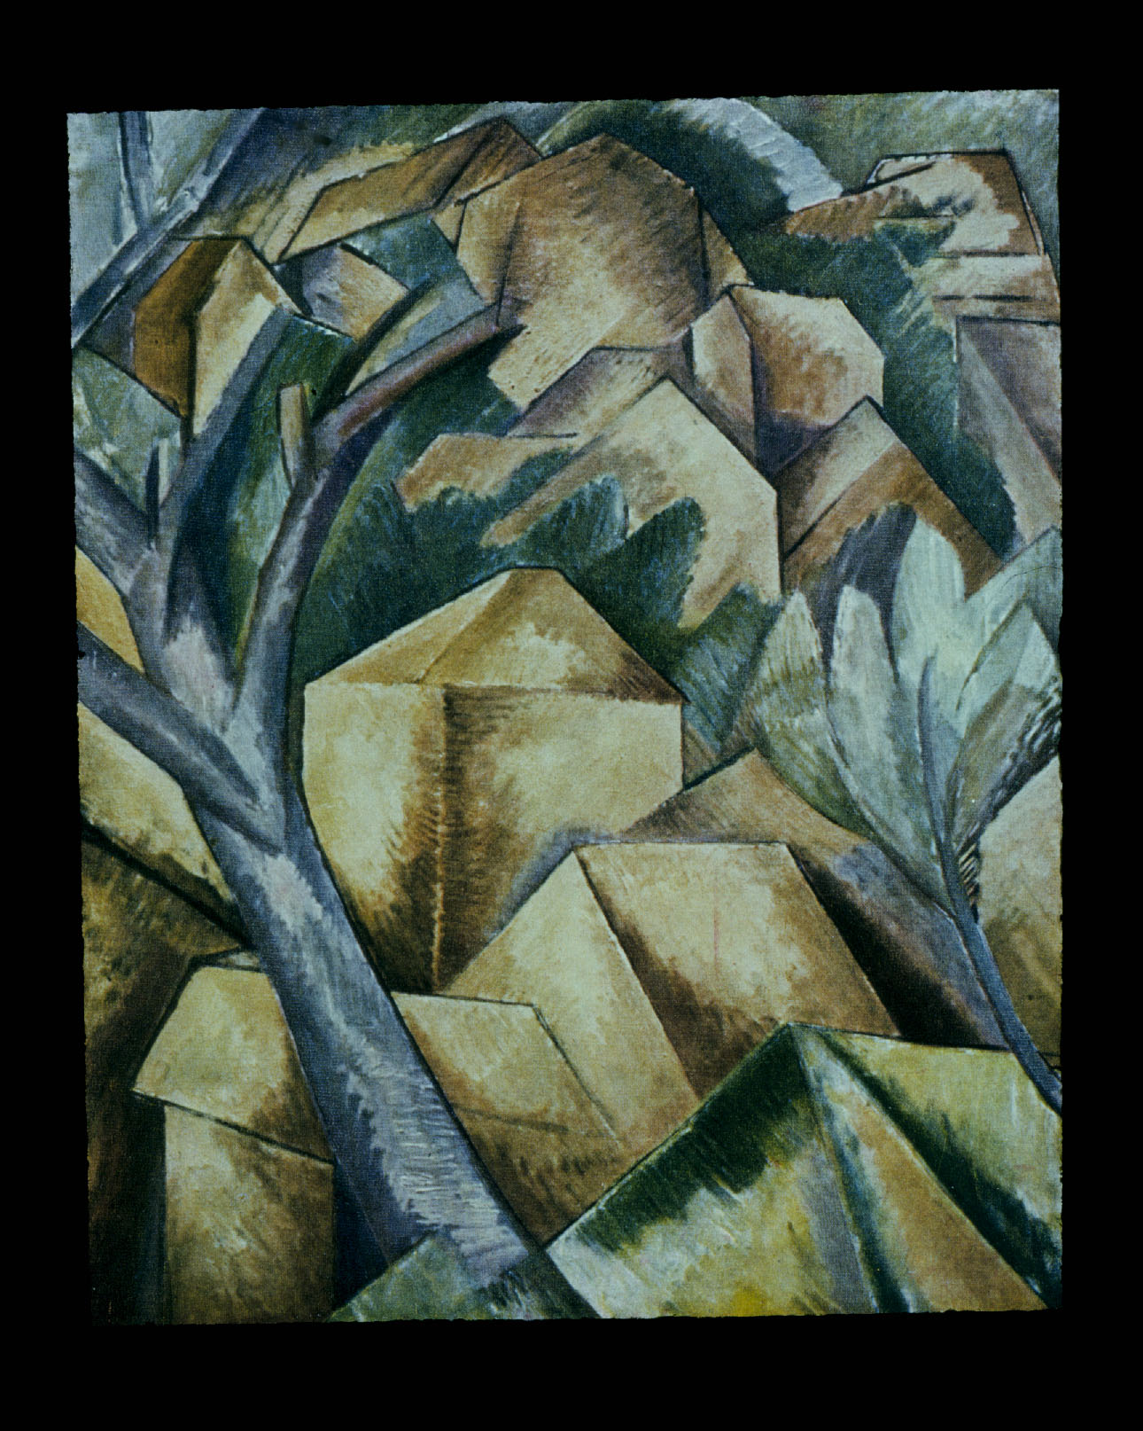
Georges Braque,
Houses at L’Estaque,
1908

Slide 9
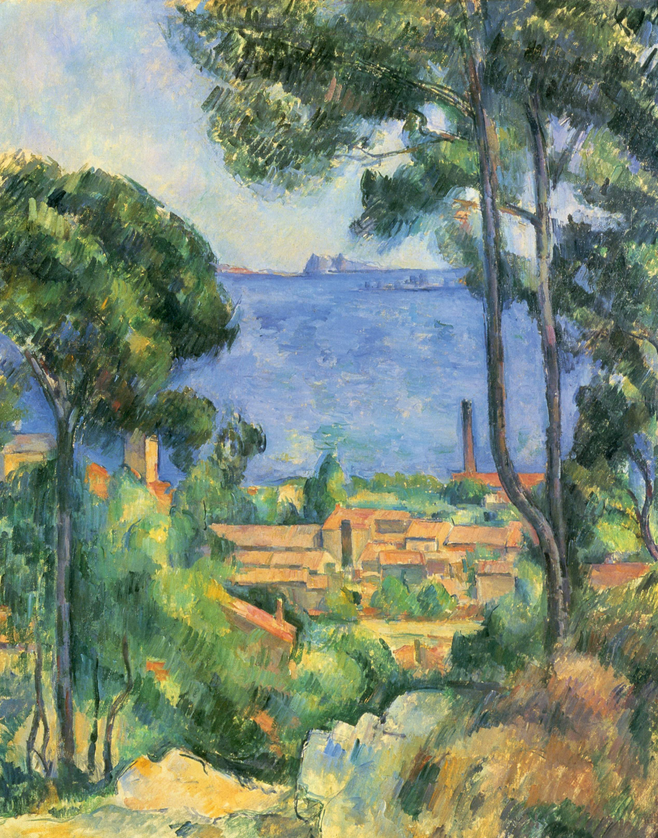
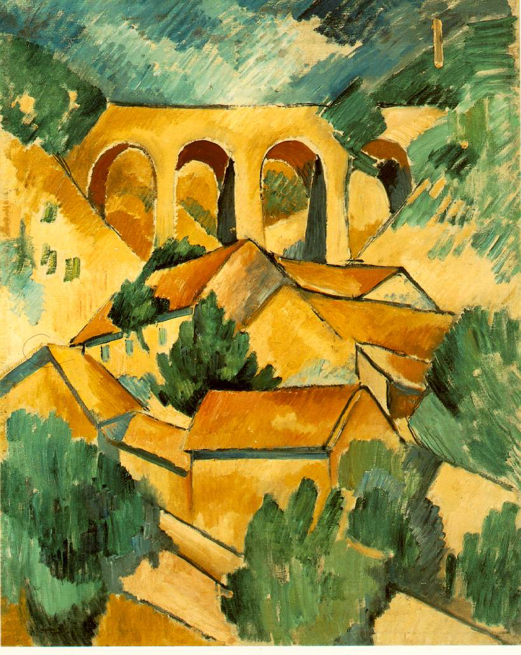
Two views of L’Estaque: Cezanne on the left (1885), Braque on the right (1908)

Slide 10
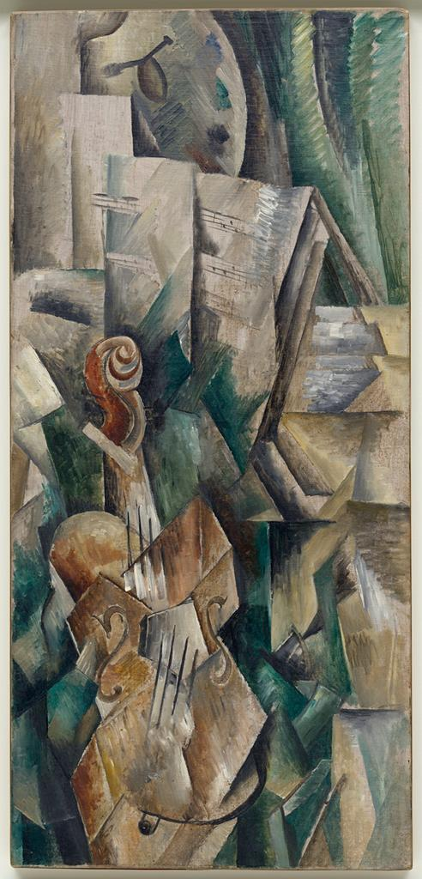
Braque
Violin and Palette
1909

Slide 11
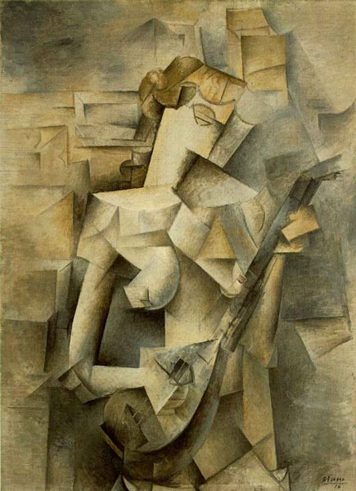
Picasso, Girl with Mandolin, 1910

Slide 12
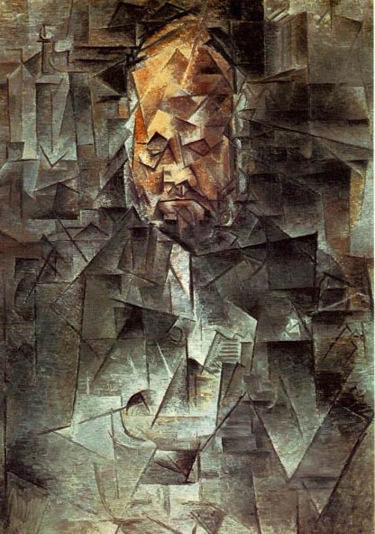
Picasso
Portrait of Ambroise Vollard,
1910-11

Slide 13
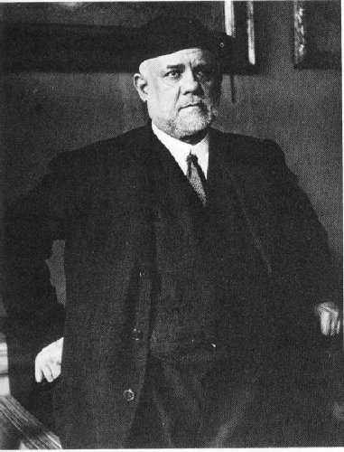

Slide 14
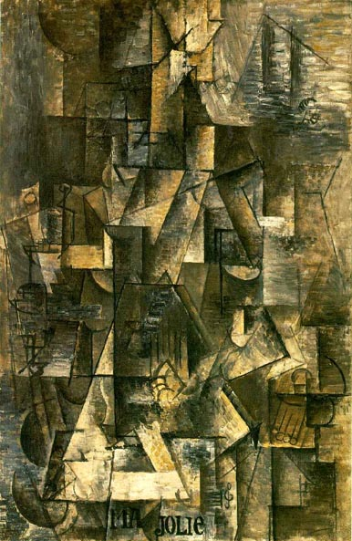
Picasso, Ma Jolie, 1911

Slide 15
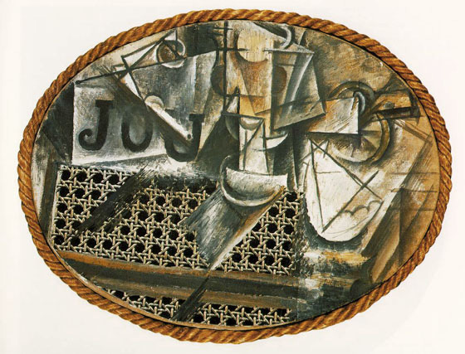
Picasso, Still Life with Chair Caning, 1913

Slide 16
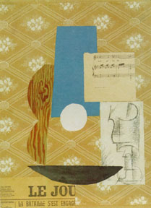
Picasso, Guitar and wineglass, 1912

Slide 17
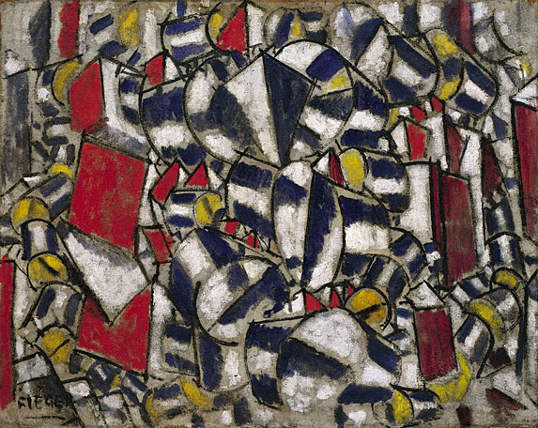
Fernand Leger, Contrast of Forms, 1913

Slide 18
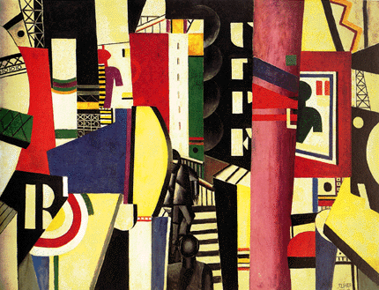
Leger, The City, 1919

Slide 19
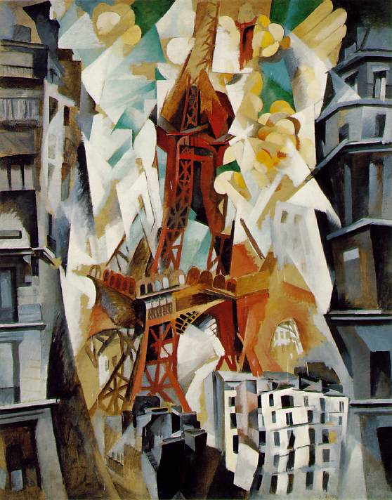
Robert Delaunay,
Eiffel Tower, c. 1910

Slide 20
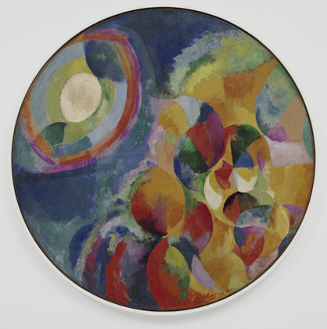
Robert Delaunay, Simultaneous Contrasts: Sun and Moon, 1913

Slide 21
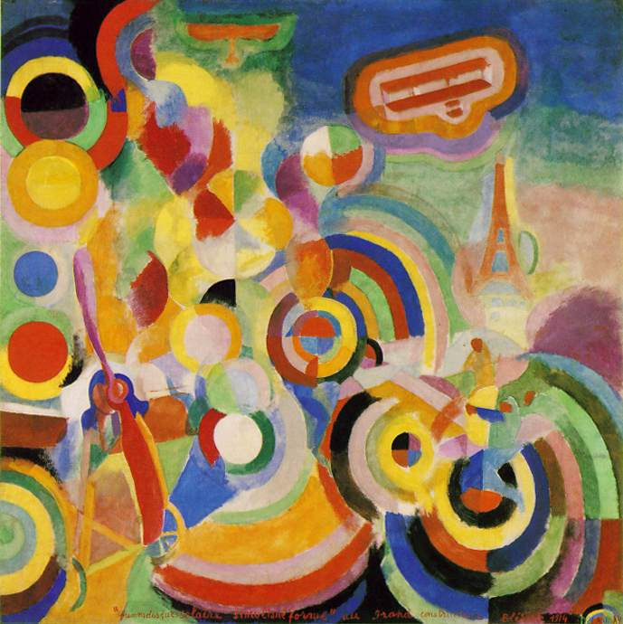
Robert Delaunay
Homage to
Bleriot, 1914

Slide 22
Sonia Delaunay, Poem on the Transsiberian
Railroad, 1913

Slide 23
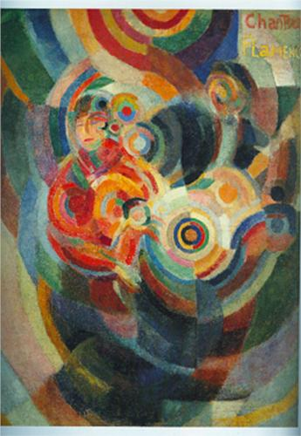
Sonia Delaunay, Flamenco
Dancer, 1916

Slide 24
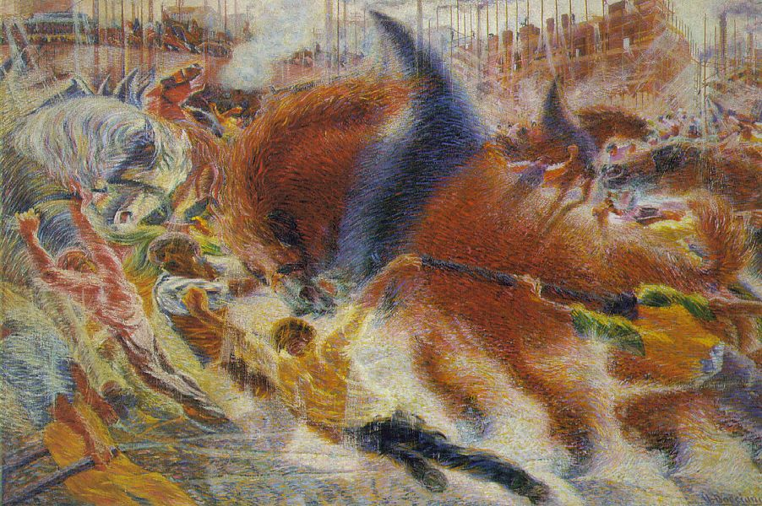
Umberto Boccioni, The City Rises, 1910

Slide 25
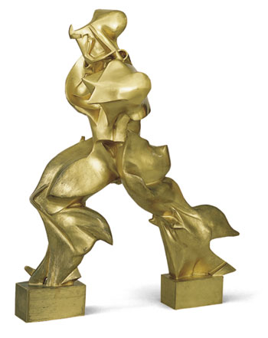
Boccioni, Unique Forms of Continuity in Space, 1911

Slide 26
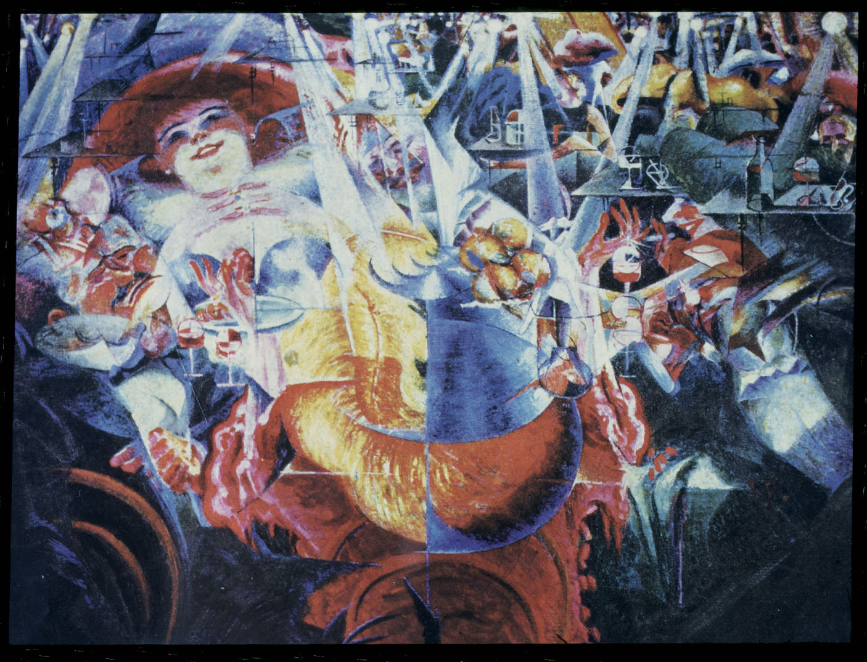
Boccioni, The Laugh, c. 1912

Slide 27
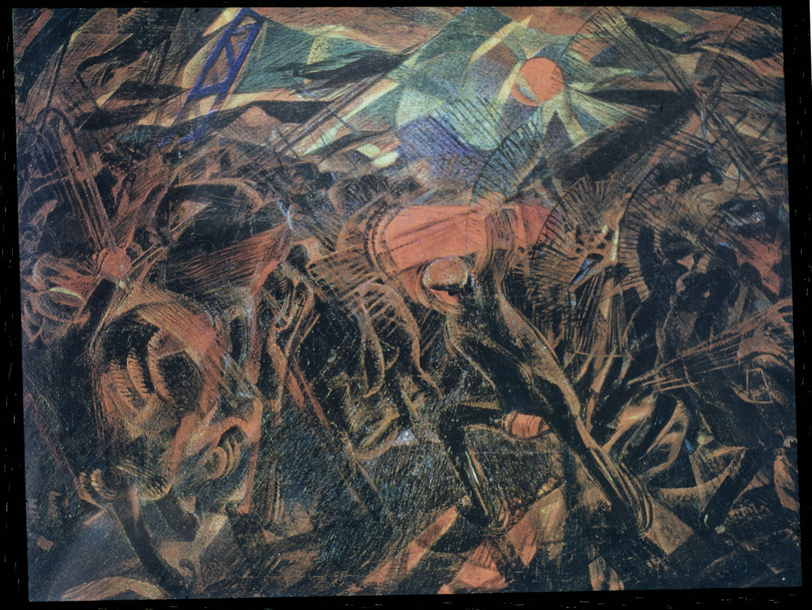
Carlo Carra, Funeral of the Anarchist Galli, 1910-11

Slide 28
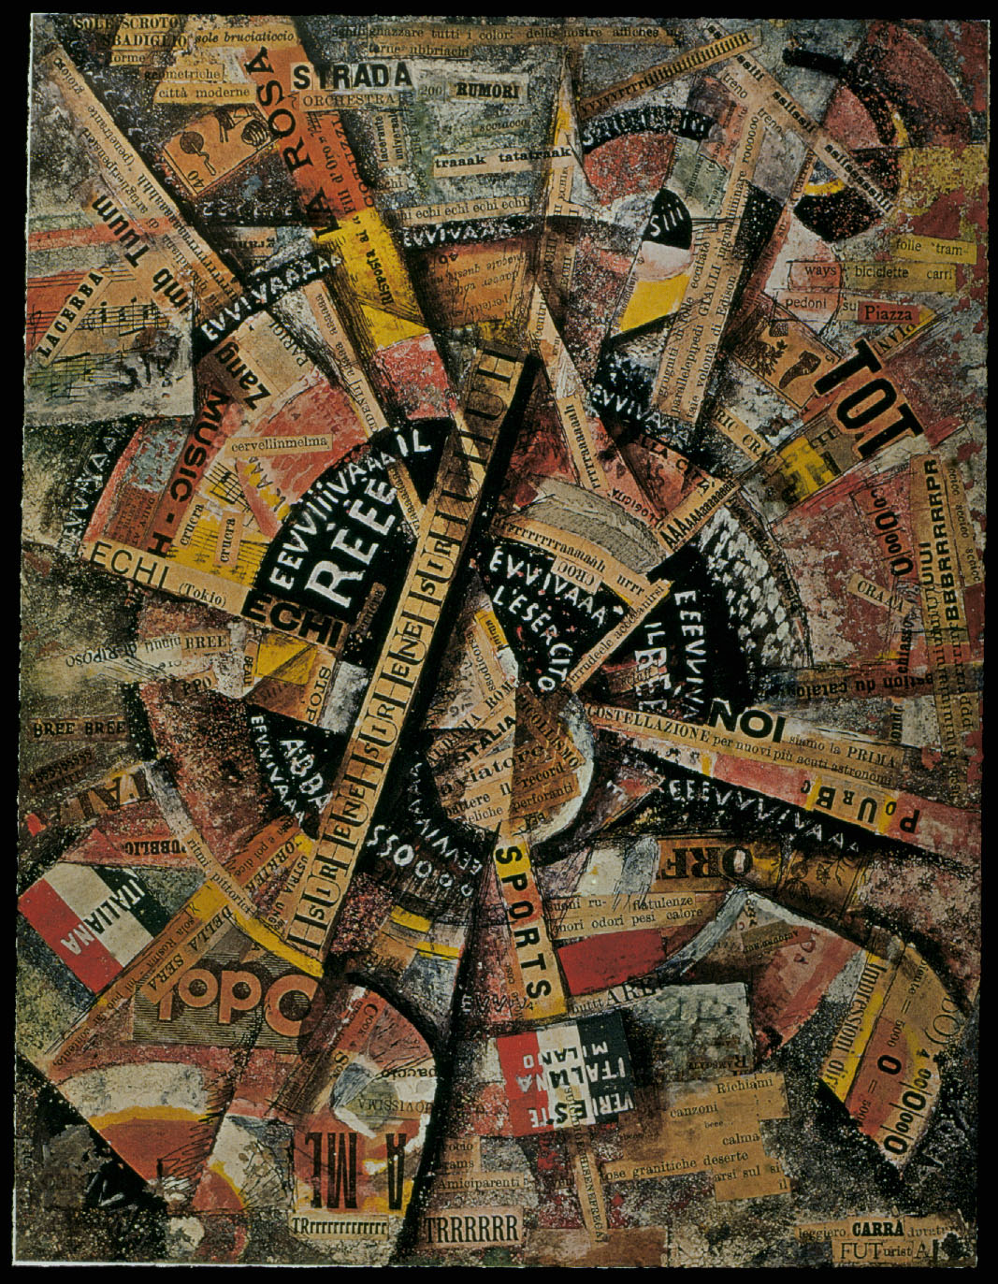
Carra,
Interventionist Manifesto

Slide 29
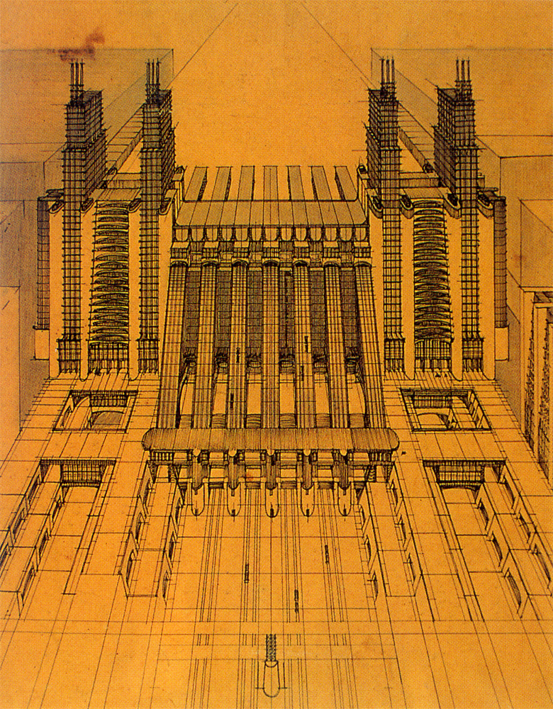
Antonion Sant’Elia
Citta Nuova
Project for an
Airport/Train station
1914

